Slide 1
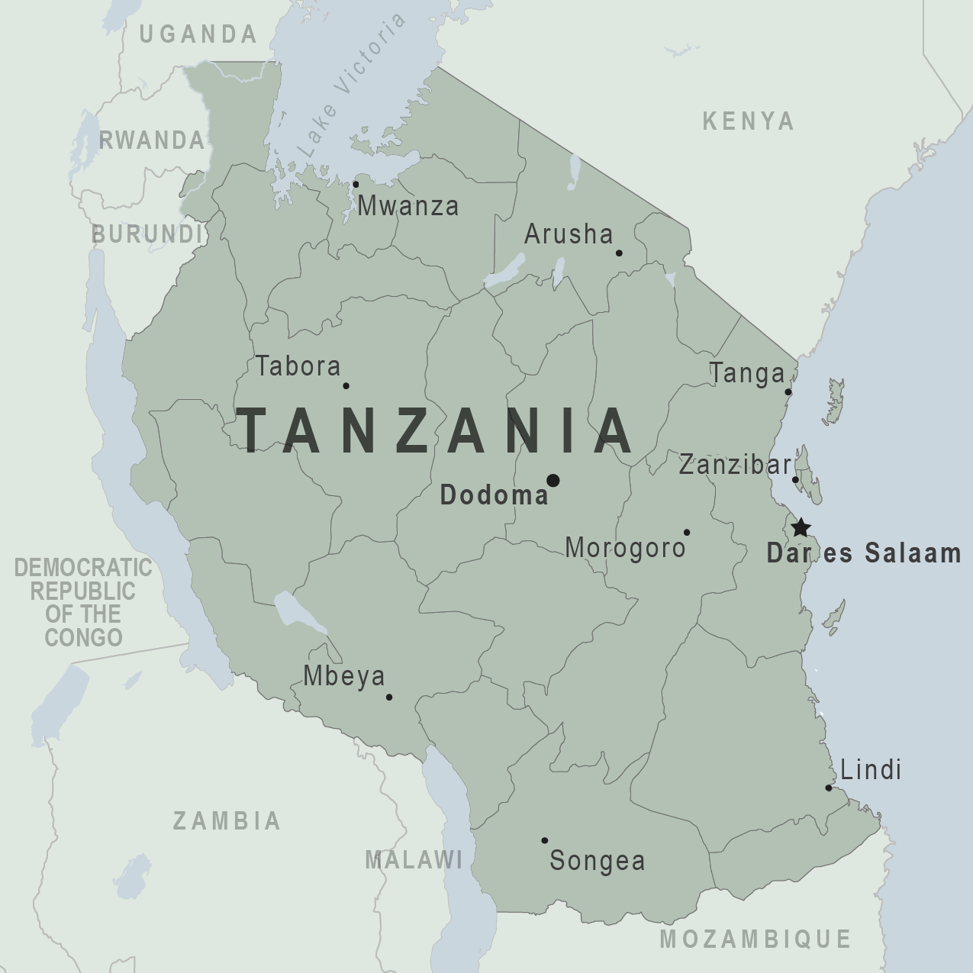
Tanzania Water Wells
BY KARAN KURDIA

Slide 2
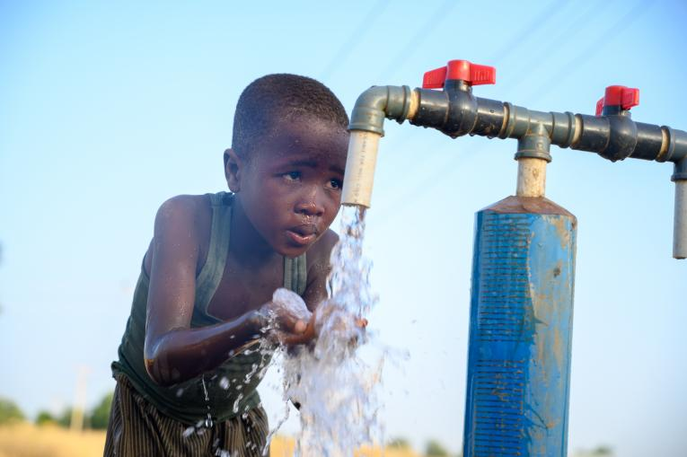
Business Problem
Tanzania is a developing country
It has a very large population of over 57 million
The country struggles to provide clean water
Notes:
Tanzania is a developing country, that struggles to provide clean water to its population of over 57,000,000 (57 million)

Slide 3
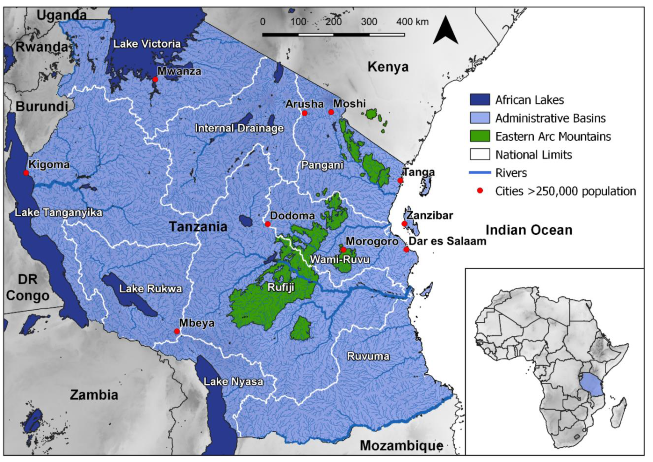
Scope and Data
To create a model that helps predicting, the waterpoints that are functional and non functional.
This would, help the Government know the areas it should be focusing more on, in order to provide proper cleaning water to its population
Data acquired from DrivenData.org
59400 rows, 40 columns
Notes:
Tanzania is a developing country, that struggles to provide clean water to its population of over 57,000,000 (57 million)

Slide 4
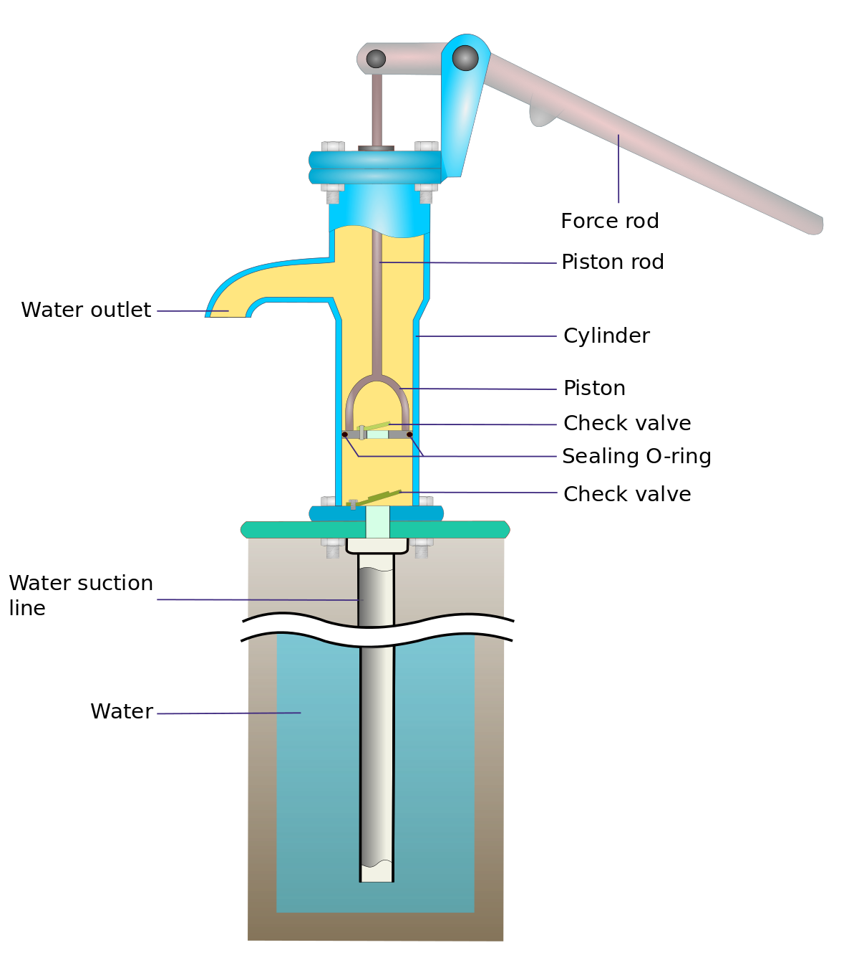
Waterpoints
Its an area or source of water for the population.
The waterpoints can be functional or non funtional
Eg: Wells, Tube wells, Well pumps , handpump

Slide 5
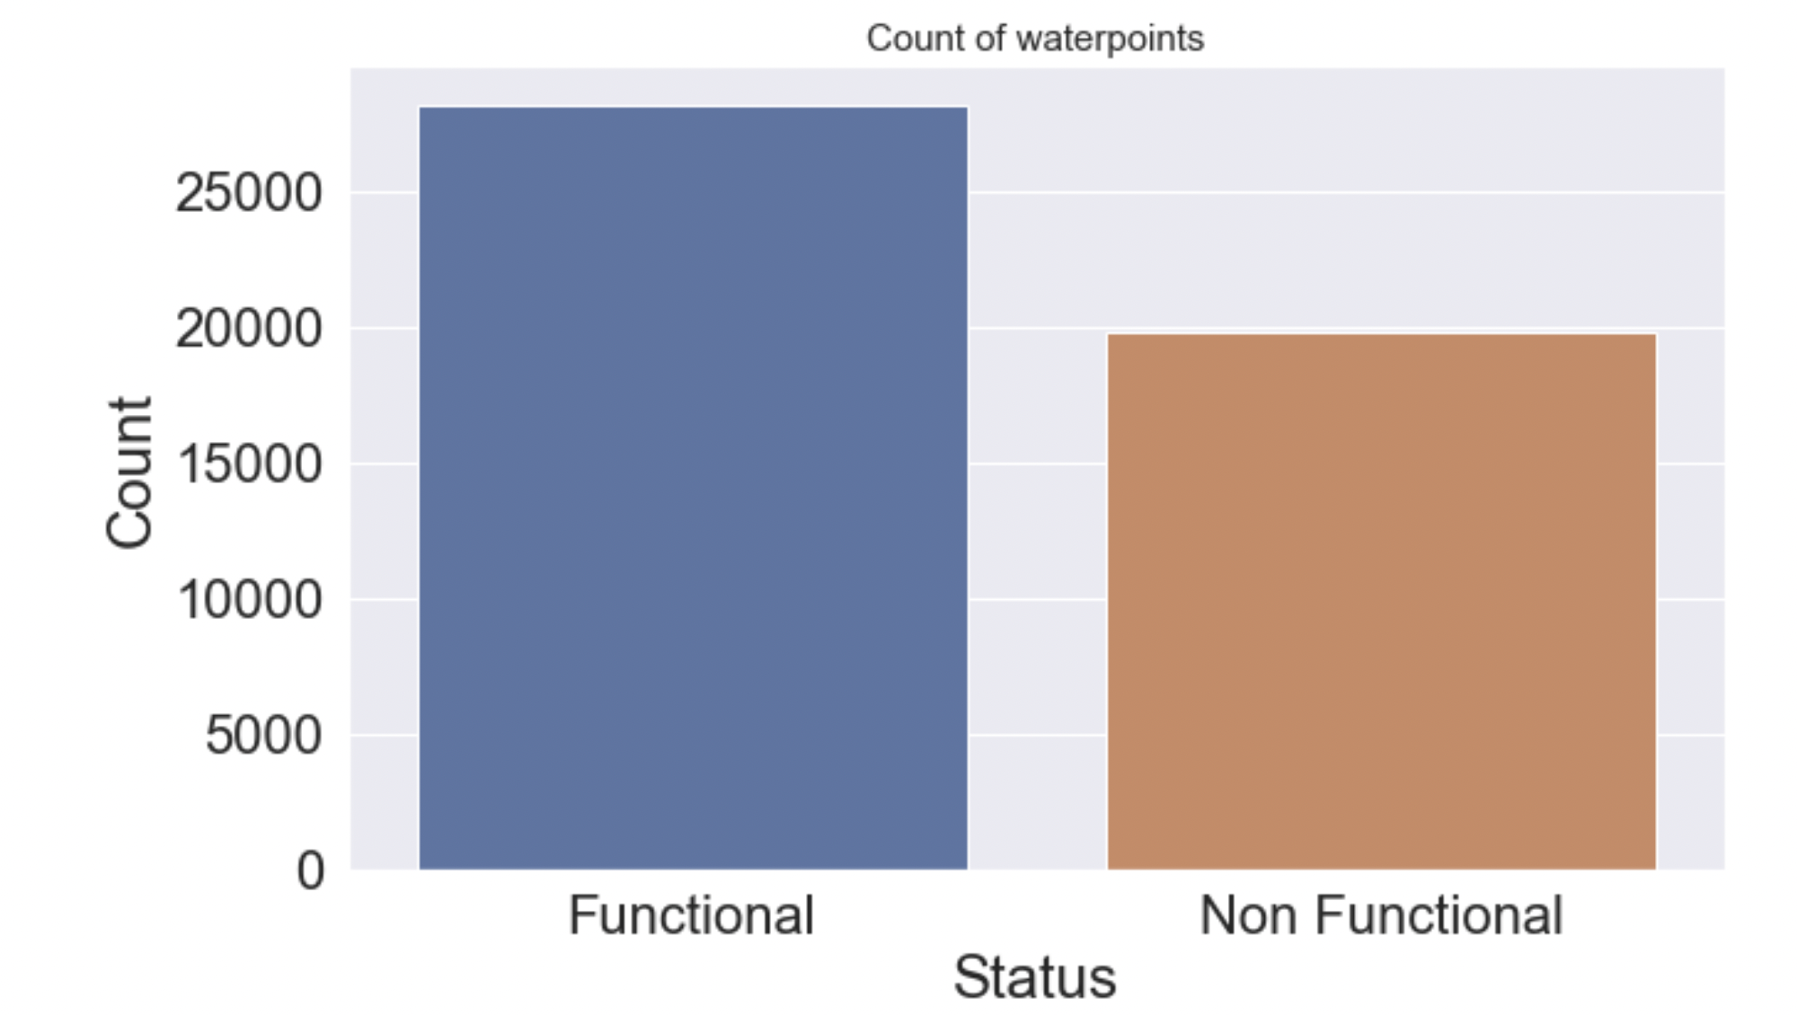
Functional and Non Functional count
Functional : 28178
Non-Functional Counts : 19821
Not much difference between the two
Means lots of population depends on the few functional ones.
Notes:
The waterpoints that are functional are 28178 and non functional are 19821

Slide 6
Features

Slide 7
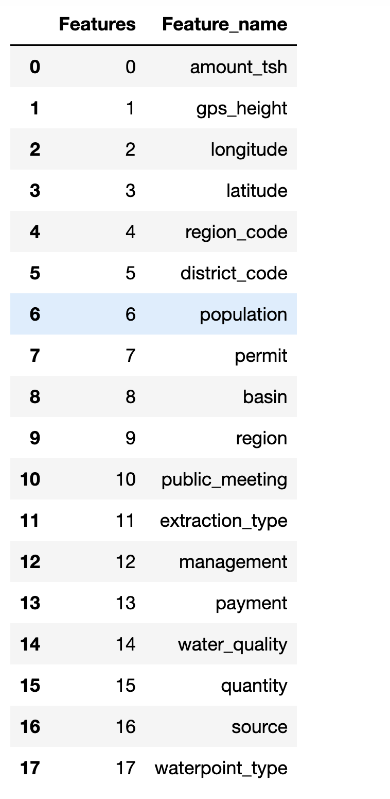
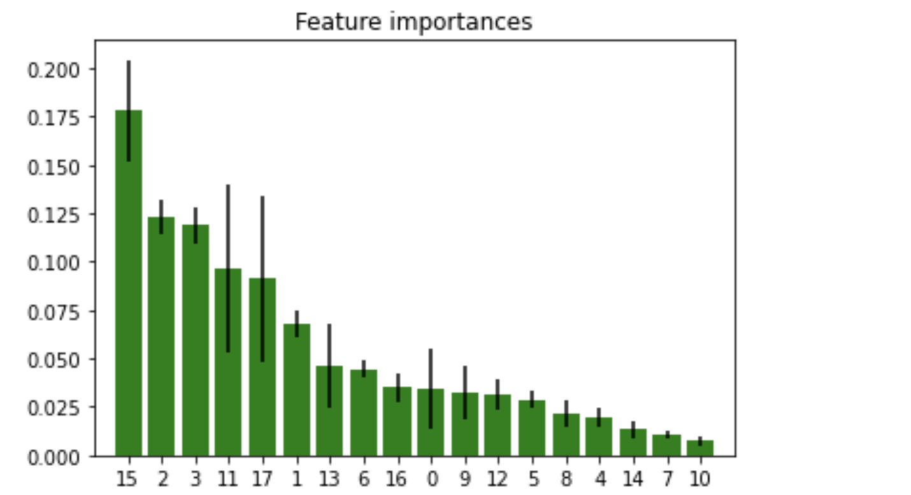
Quantity, longitude, latitude, extraction_type, waterpoint_type, gps_height, payment and region are the best performing features.
Notes:
Recall finds all positive samples(all positives)
Precision tells, the number of positive labels which are actually positive(only true positives)

Slide 8
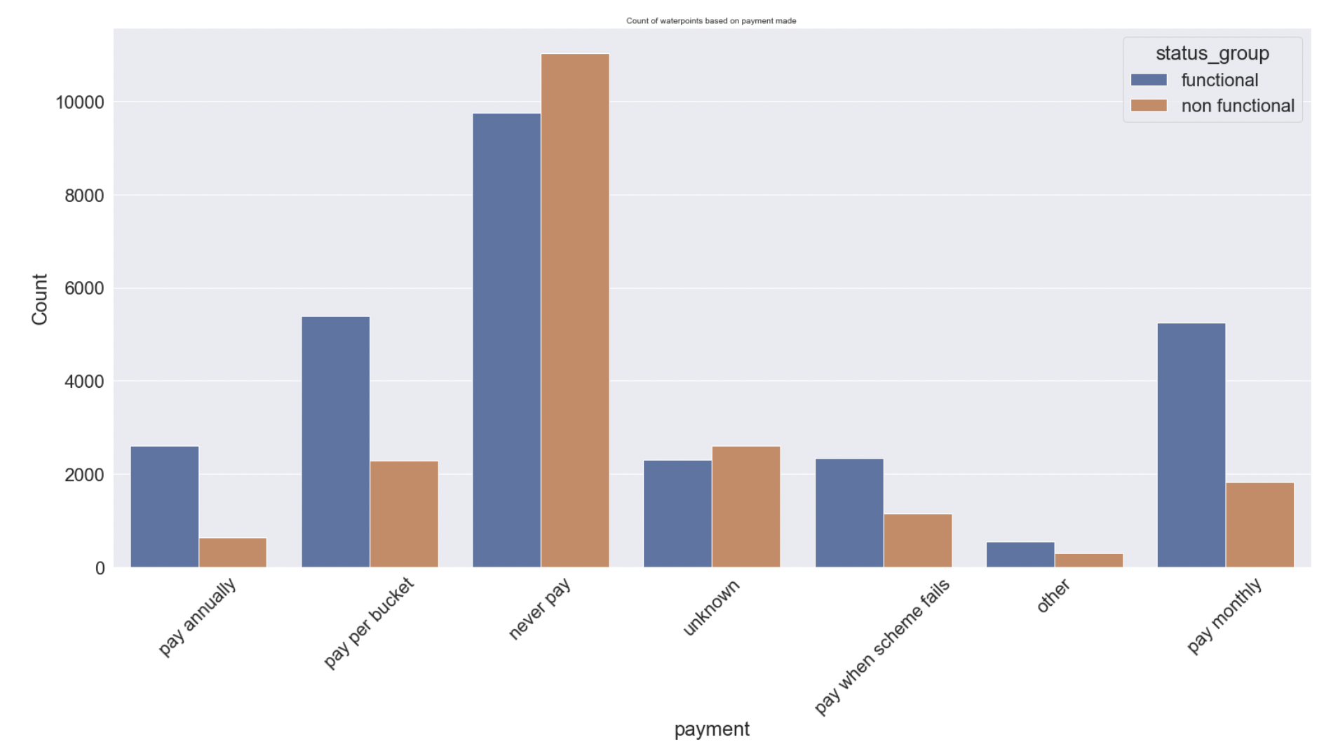
Billing for the waterpoints
Waterpoints where payments are being made are more functional
Notes:
It indicates that, may be water points are functional because of proper maintenance, which is because of payments being made on time.

Slide 9
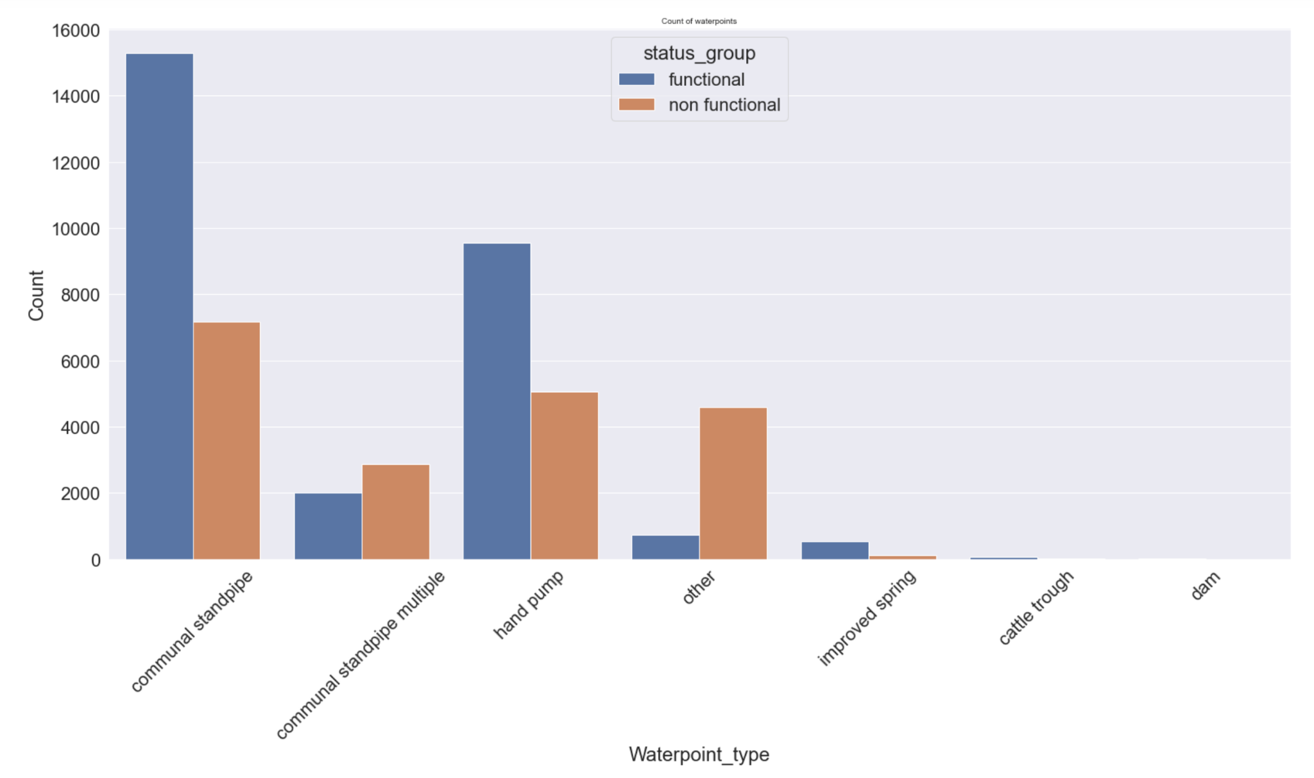
Waterpoint Type
Waterpoint types with communal standpipe and hand pump have more functional waterpoints
Notes:
It indicates that, may be water points are functional because of proper maintenance, which is because of payments being made on time.

Slide 10
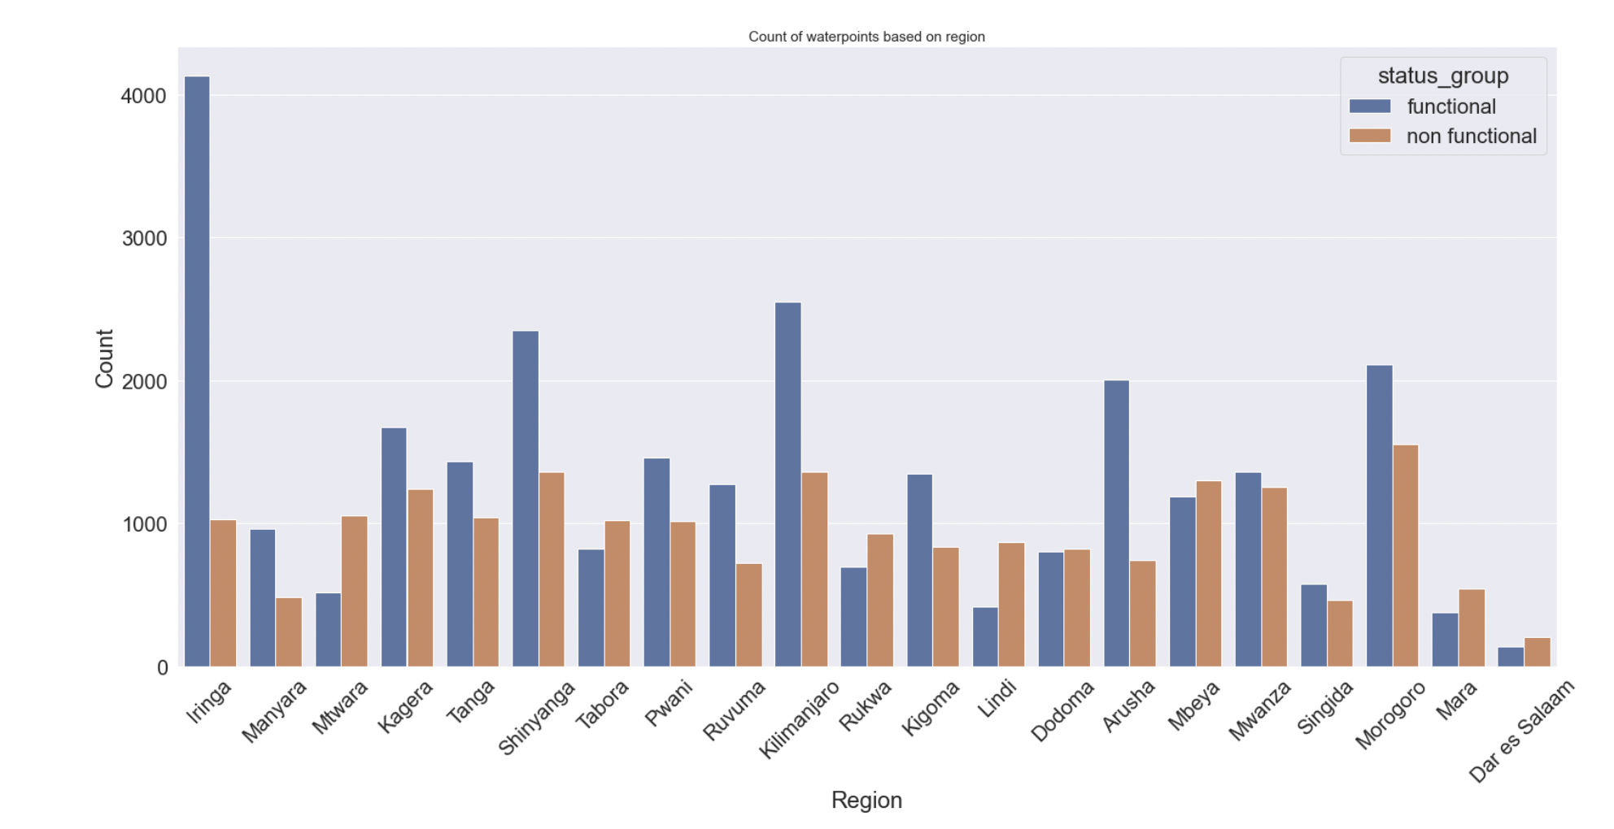
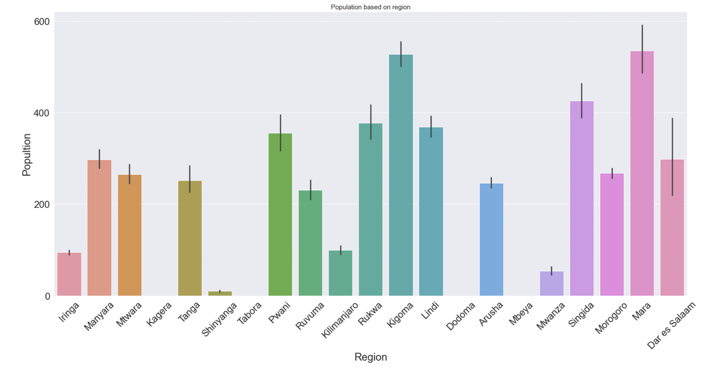
Region, Population dependency
Region with higher population have less waterpoints
There are many regions, where the populations dont have access to water. Since, many waterpoints are non functional.
Notes:
Region with higher population have have lesser waterpoints

Slide 11
Modelling

Slide 12
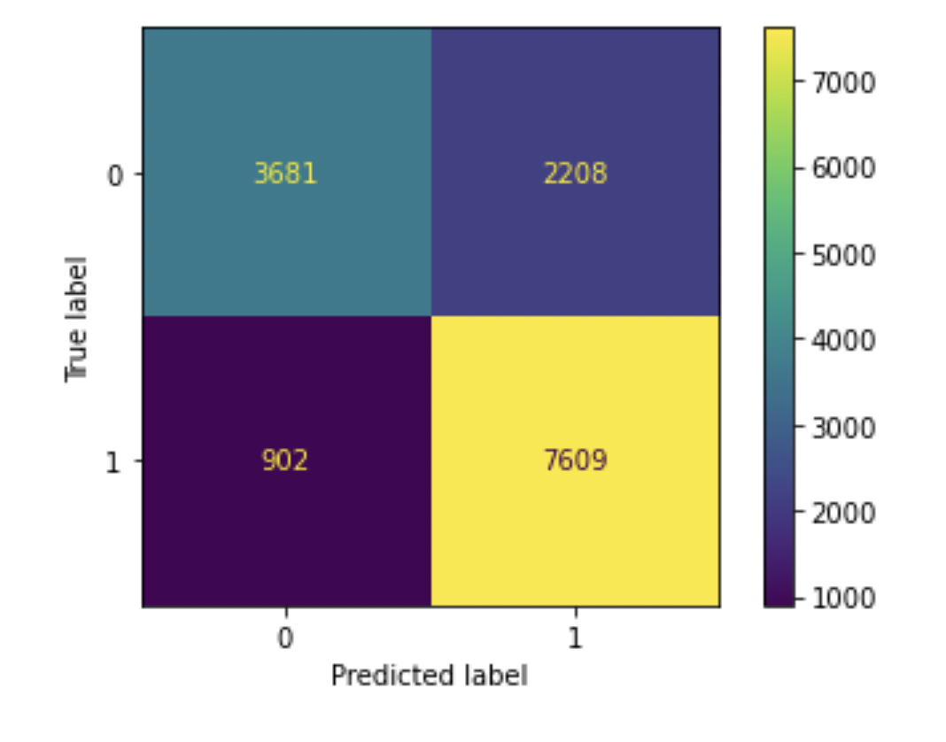
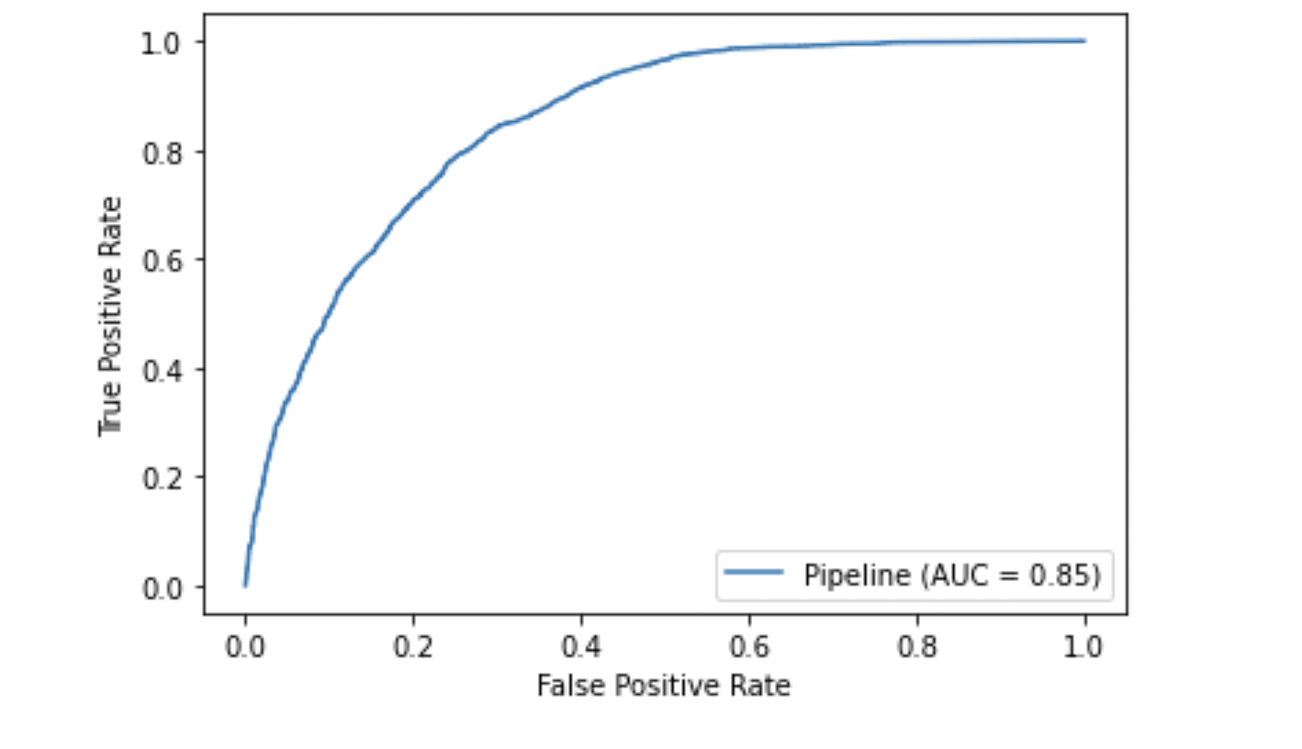
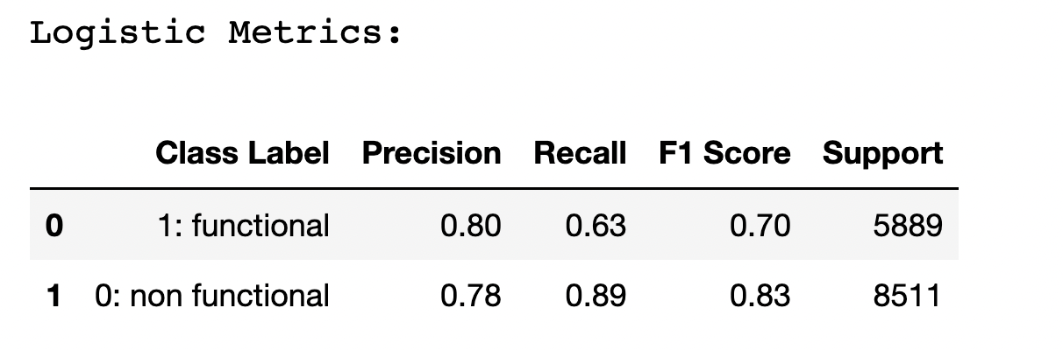
Base Model
Notes:
Recall finds all positive samples(all positives)
Precision tells, the number of positive labels which are actually positive(only true positives)

Slide 13
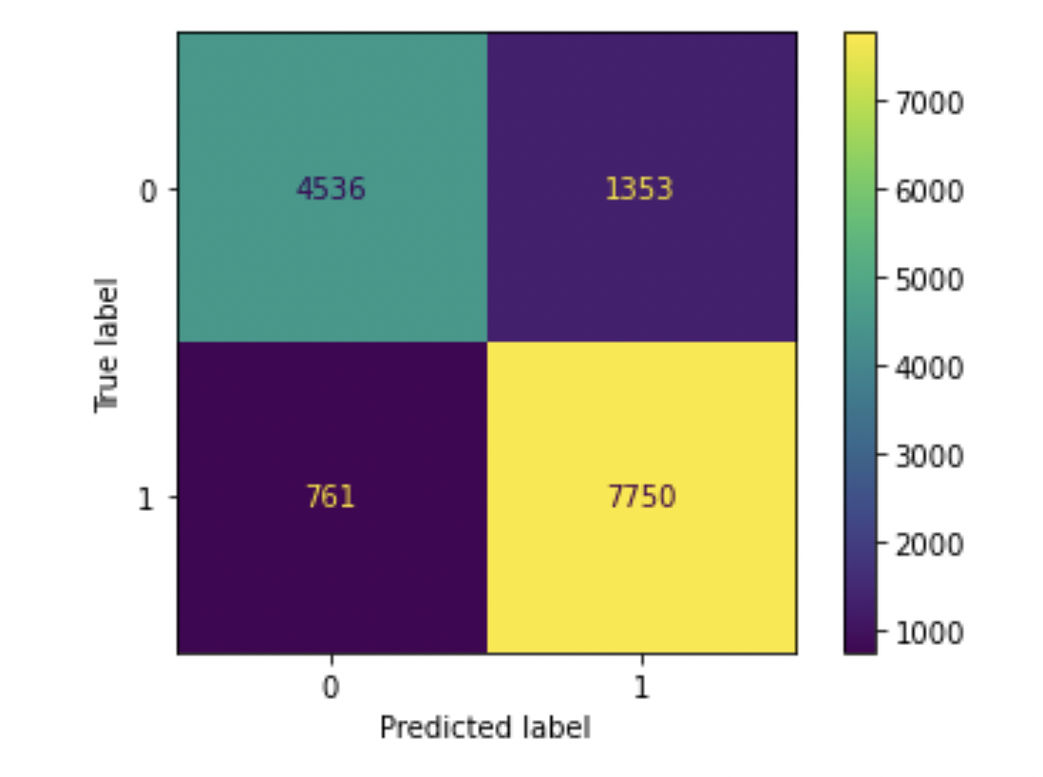
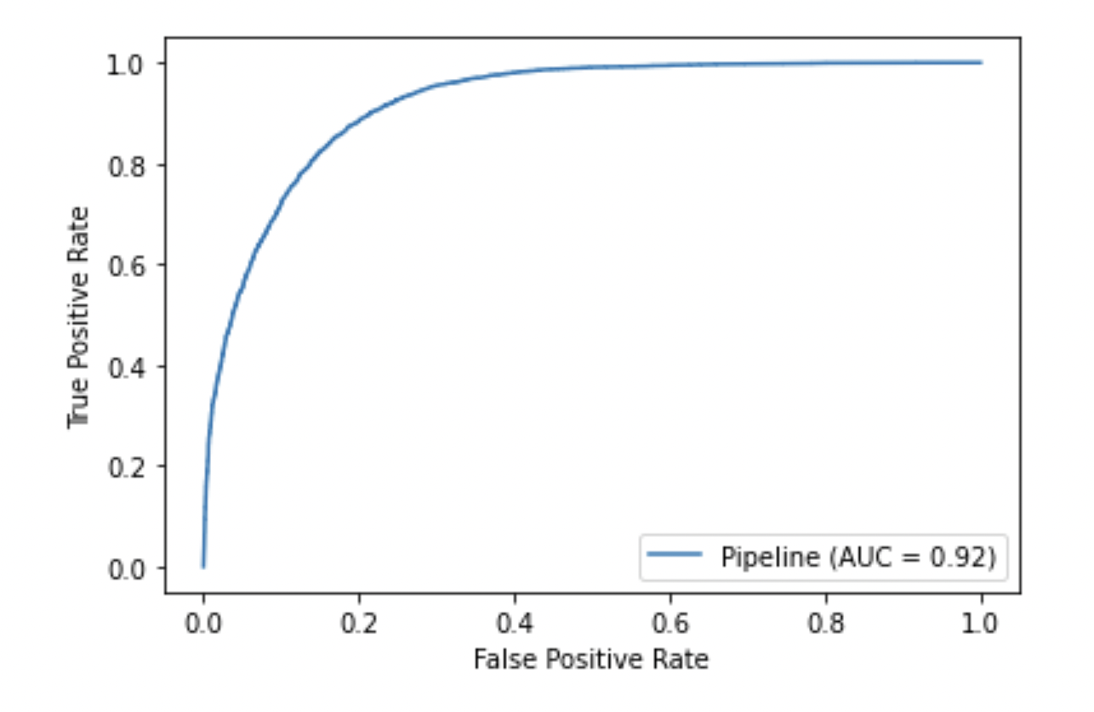
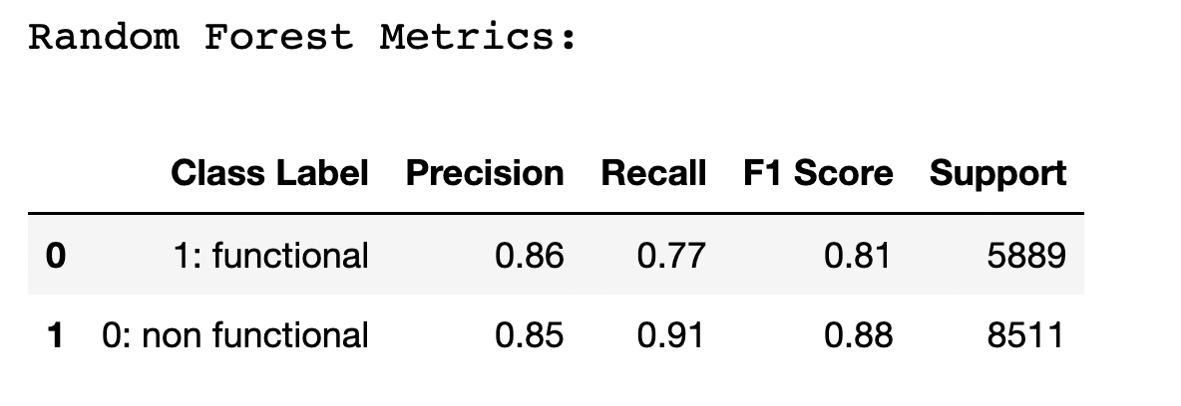
Best Model
Notes:
Recall finds all positive samples(all positives)
Precision tells, the number of positive labels which are actually positive(only true positives)

Slide 14
Summary
58% of all waterpoints in Tanzania are functional.
The model is 92% accurate.
Many waterpoints in regions with higher population are non functional
Use features features like quantity of water, extraction type of waterpoints, the height ,payments being made etc, to make further repairs on water points that are non functional
This model can be further used by the Government to analyze the future improvements.

Slide 15
Thank you

